Slide 1
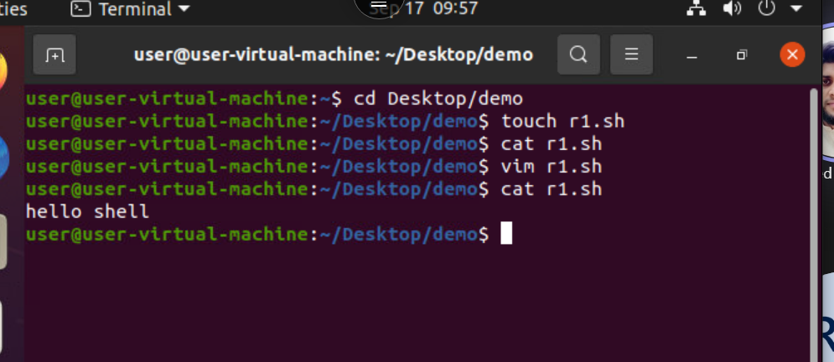
BASH SHELL
Bash is the shell, or command language interpreter, for the GNU operating system. The name is an acronym for the ' Bourne-Again SHell ', a pun on Stephen Bourne, the author of the direct ancestor of the current Unix shell sh , which appeared in the Seventh Edition Bell Labs Research version of Unix.

Slide 2
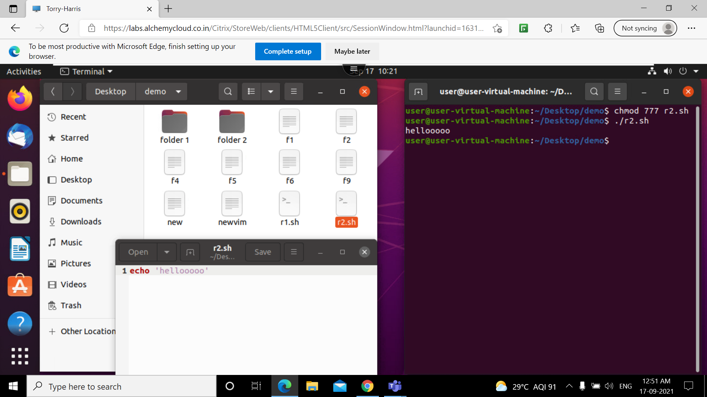
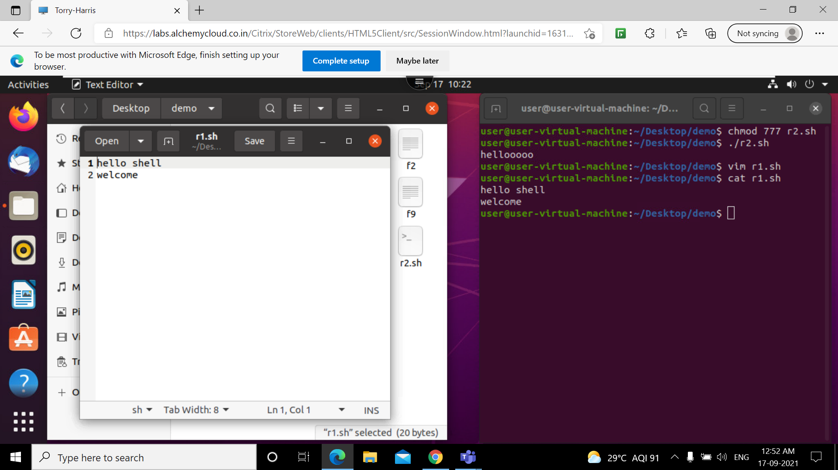

Slide 3
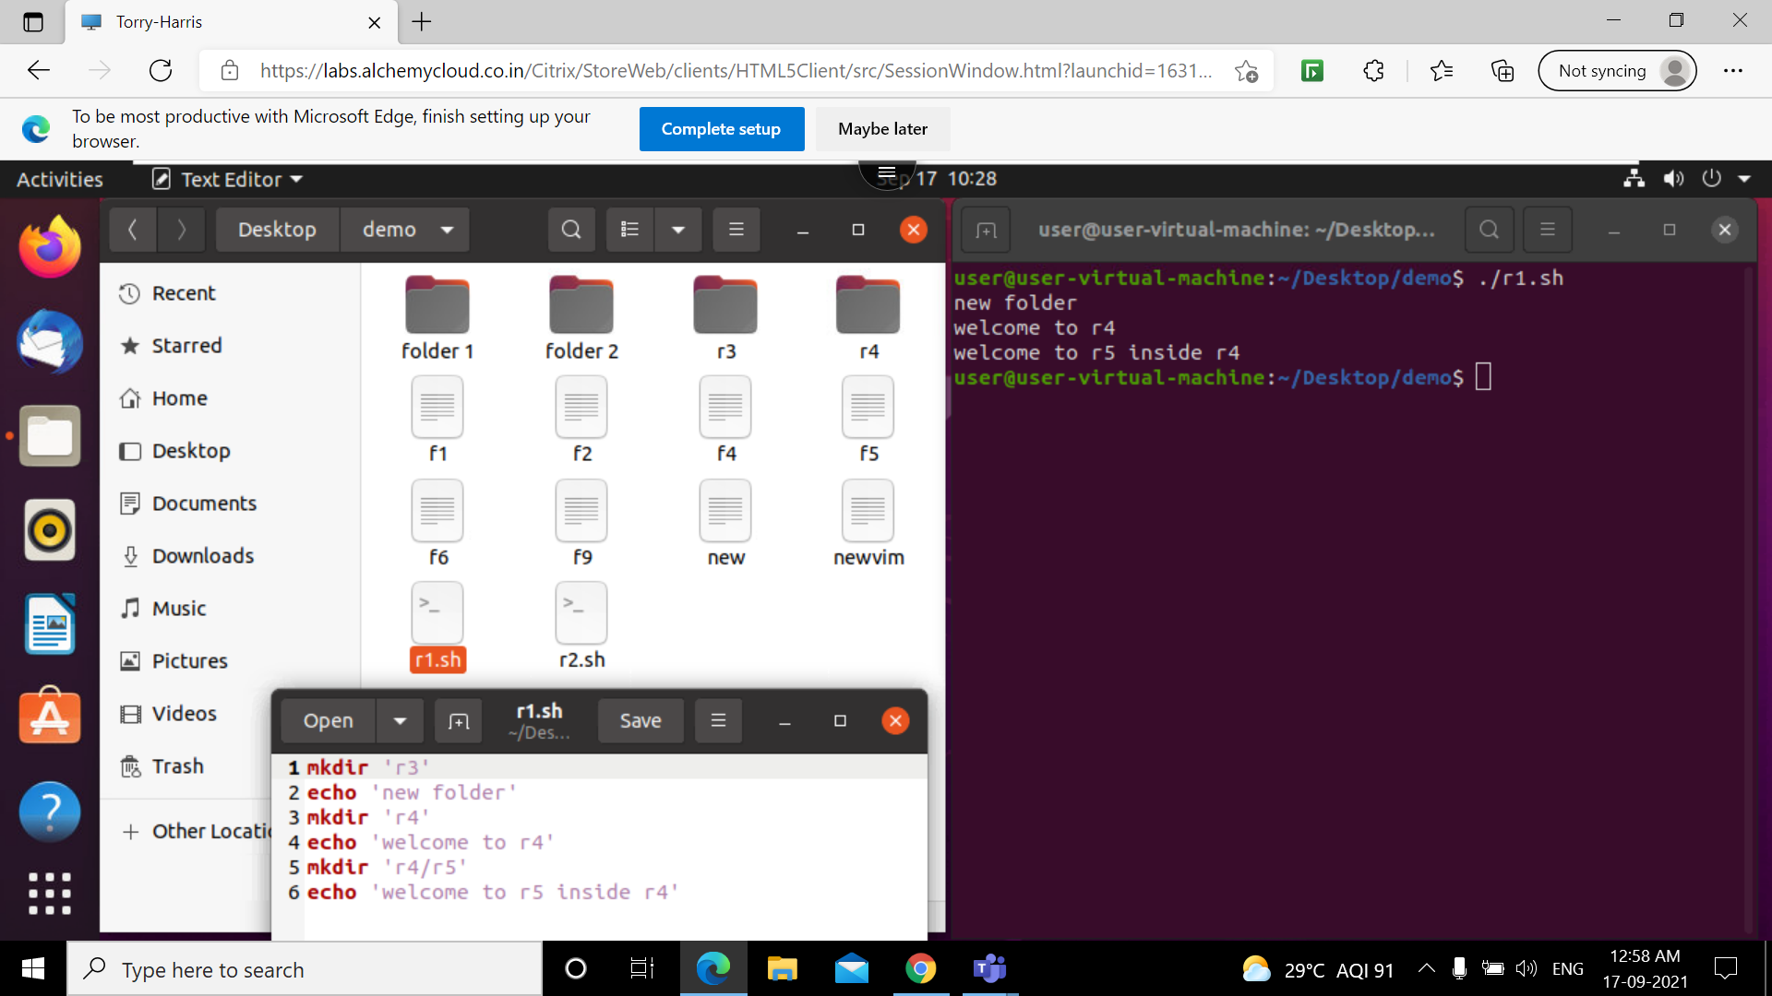
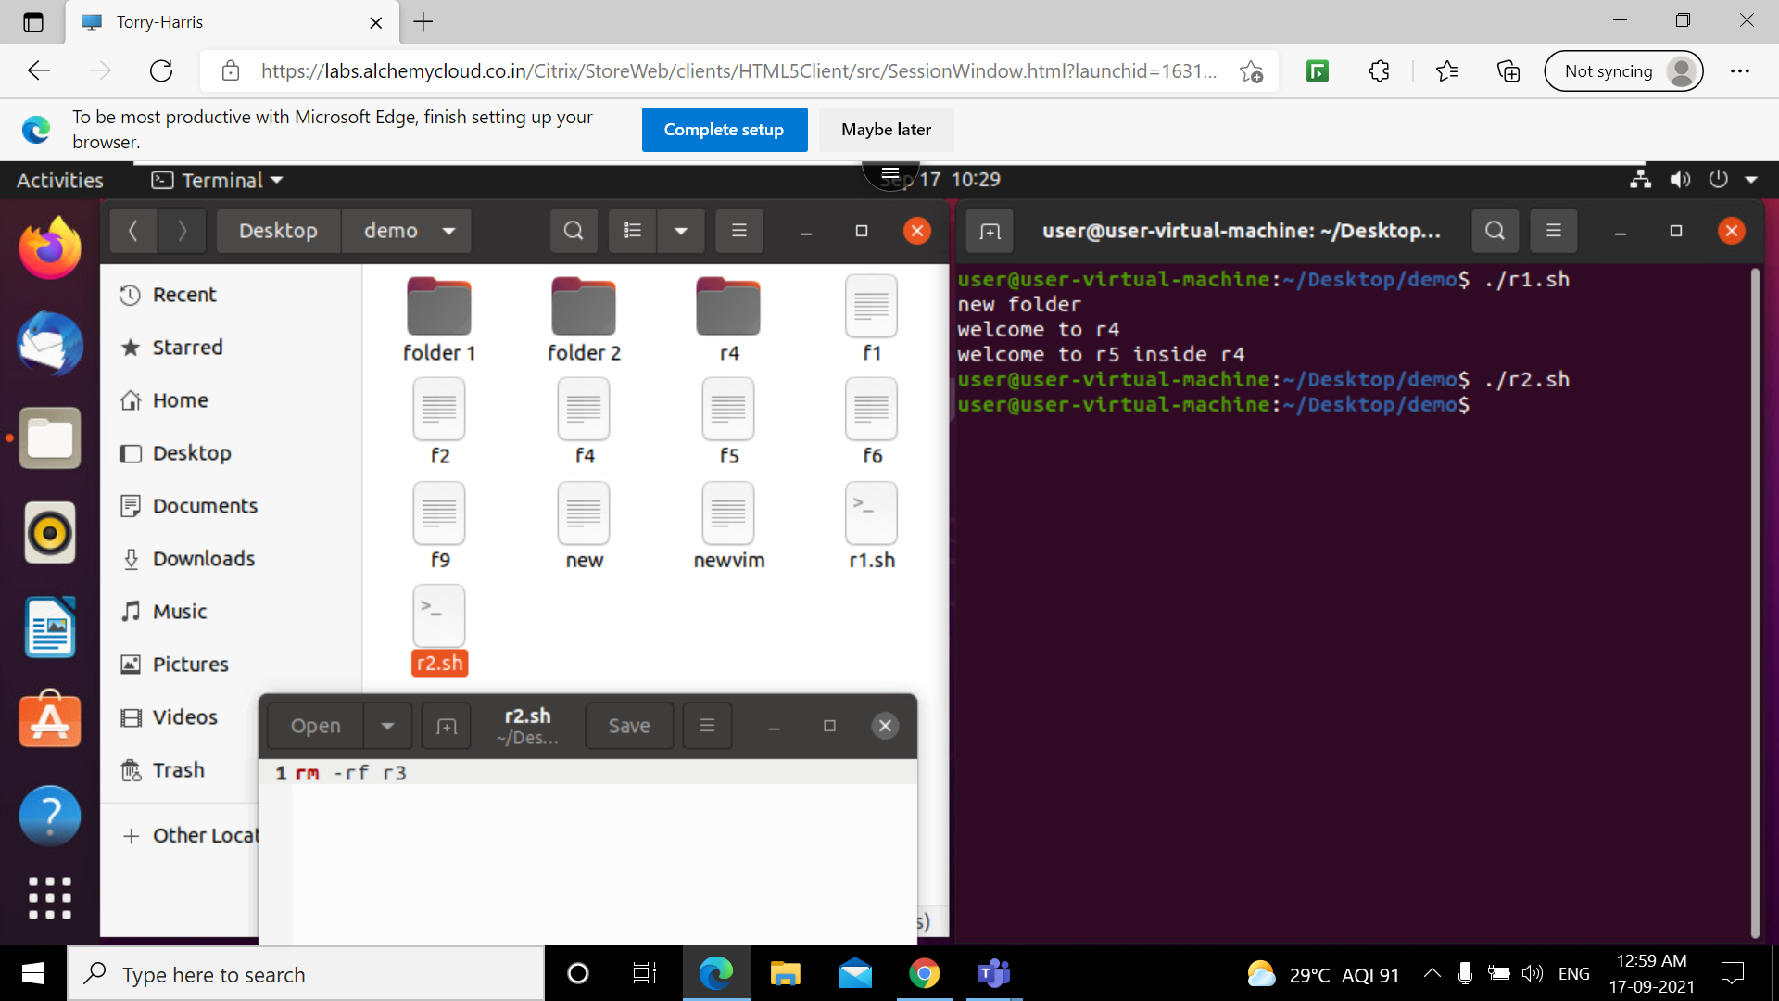

Slide 4
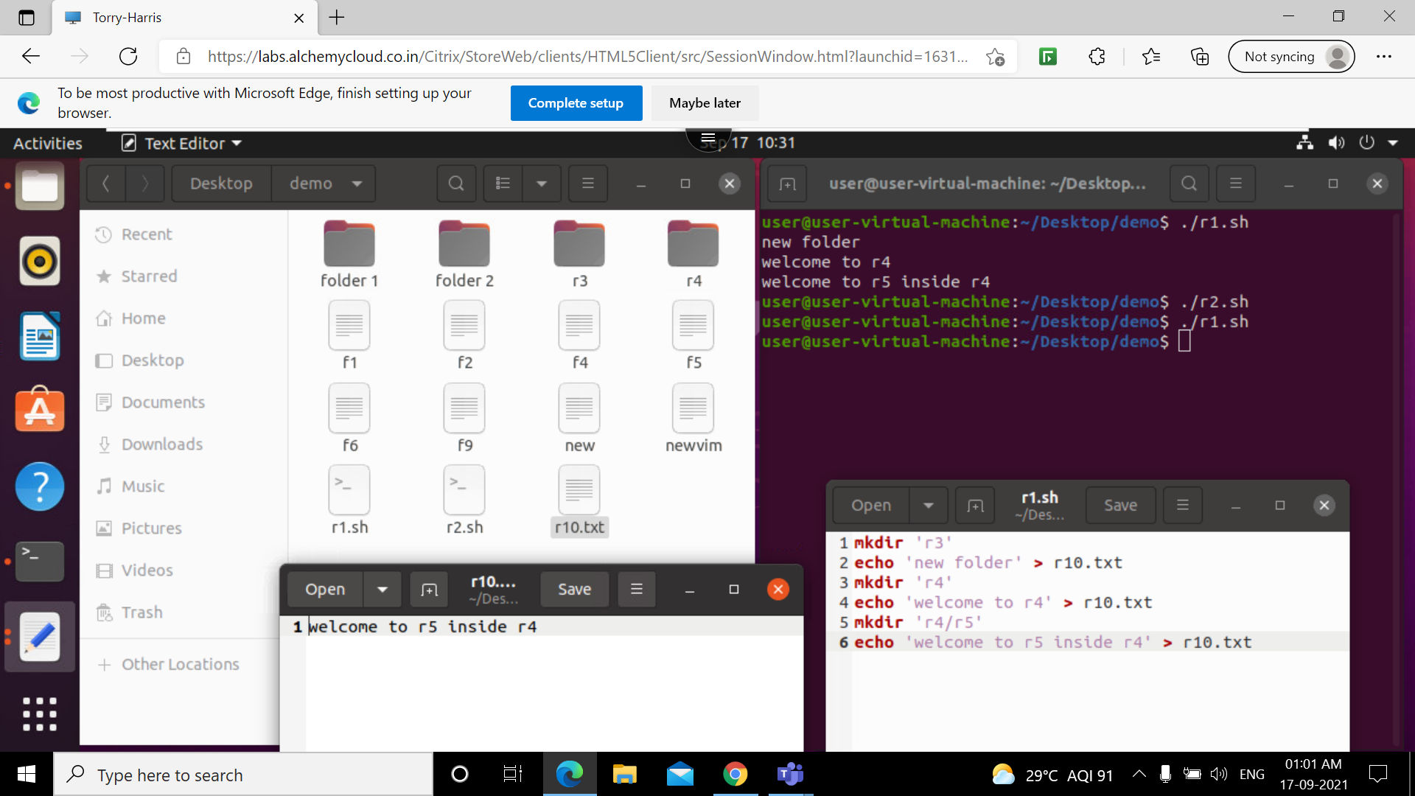

Slide 5
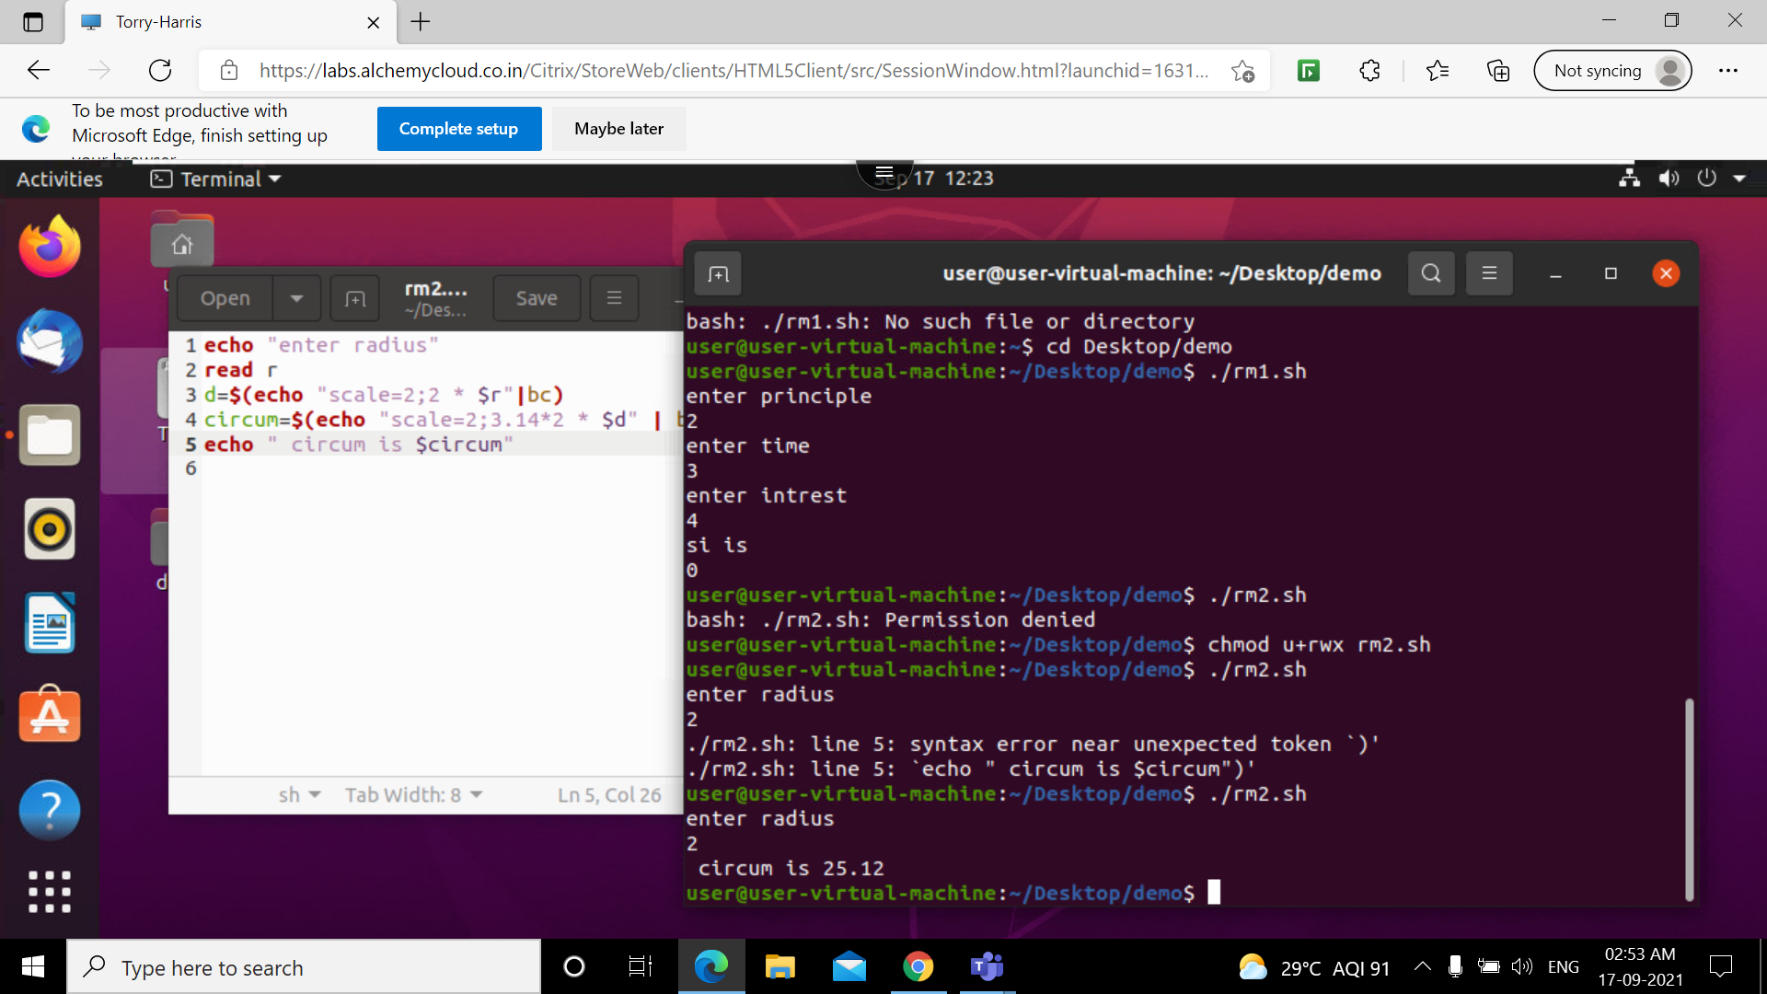
Program to find circumference of circle

Slide 6
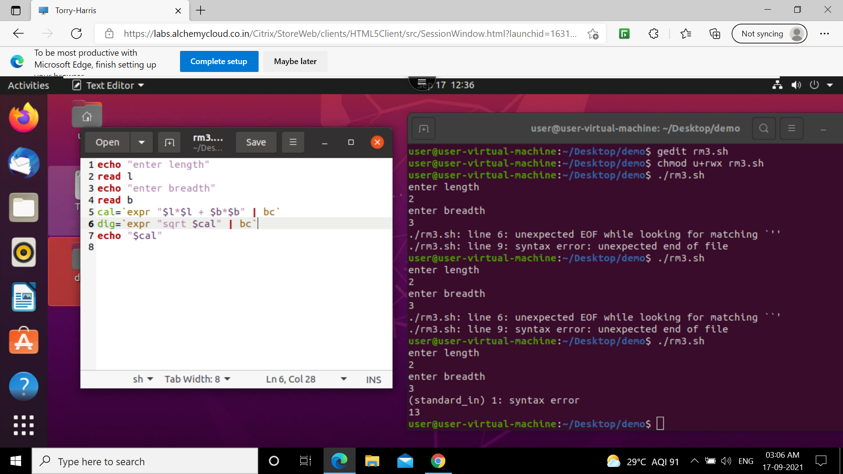
Program to find diaagonal of rectangle

Slide 7
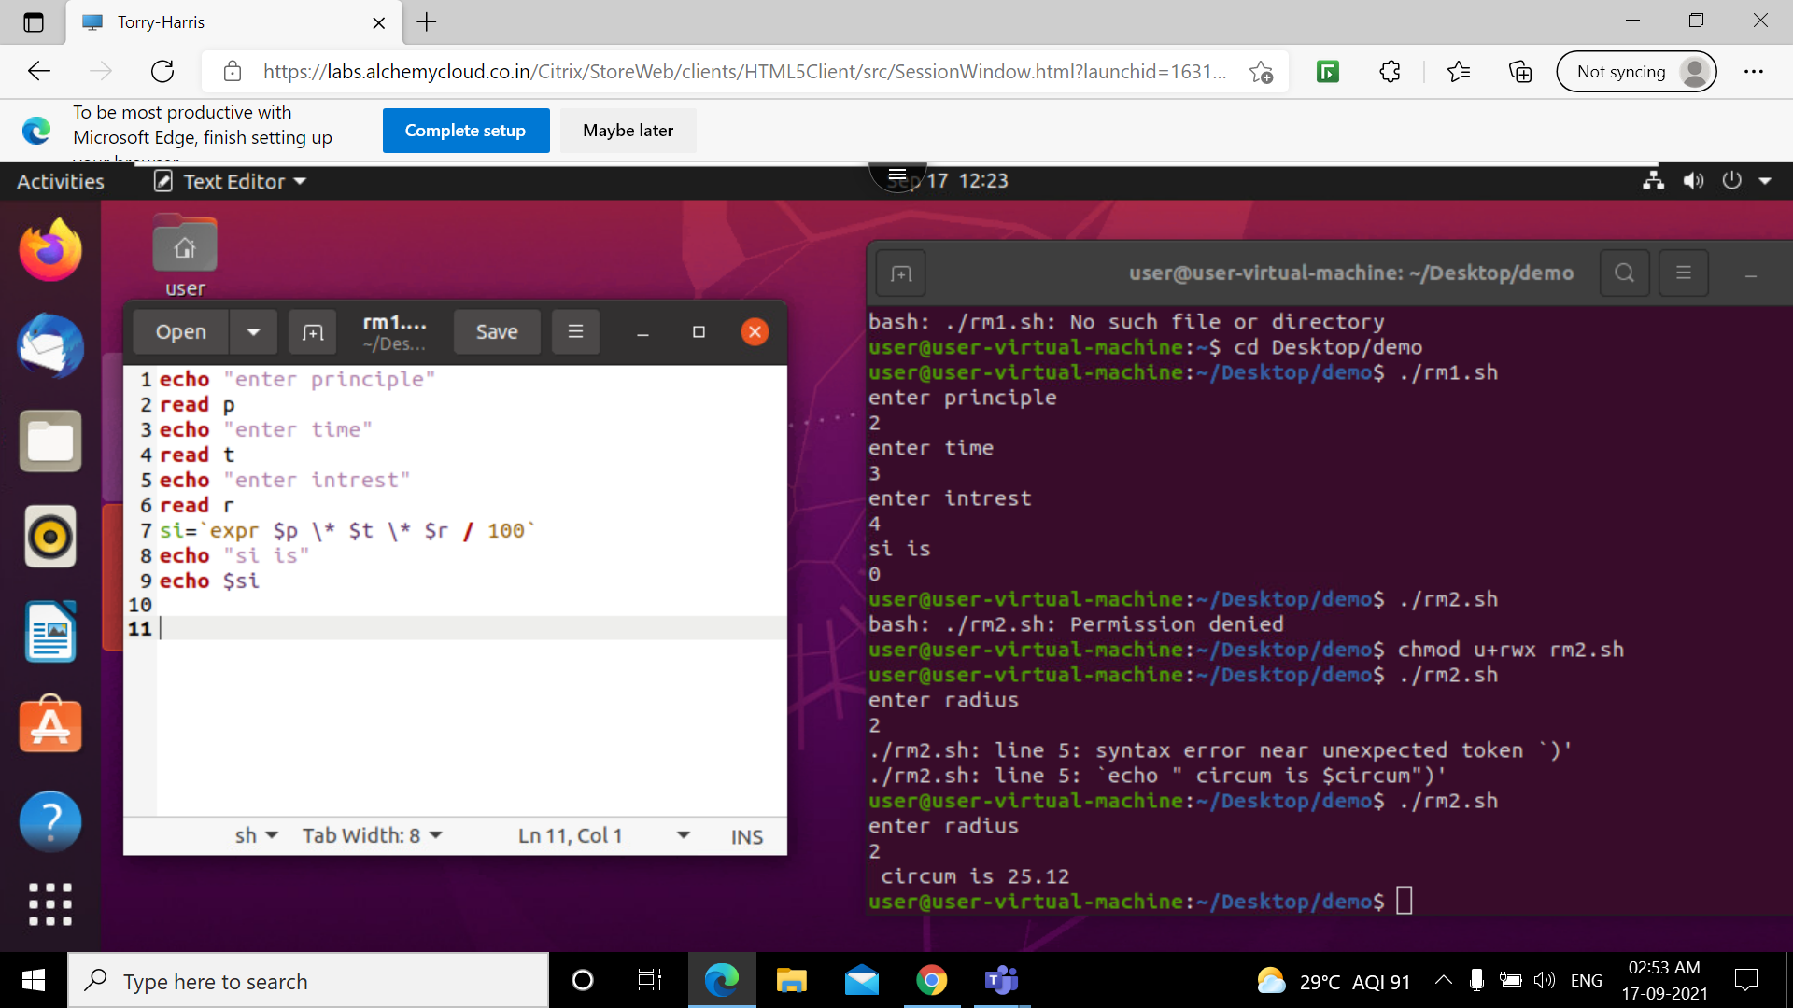
Program to find simple intrest

